Slide 1


PennyWorth
Powered to live better: budgeting that teaches you as you go.
Presented by team: Commit First, Regret Later

Slide 2







The Problem & Targeted Audience
Most 18–30 year old Mauritians can read. However, many were never taught how to manage money.
University student
A limited allowance: make it last the month.
First-time earner
First job, first salary: plan it before it disappears.
94.29%
Adult literacy rate, ages 15+
World Bank / TheGlobalEconomy.com
39%
Financially literate
S&P Global FinLit Survey (2024)
Young professional
Rising costs: build savings goals and habits.
Independent young adult
Living away from family: prioritise rent, bills and food.
Almost everyone can read. Fewer than 4 in 10 are financially literate.
PennyWorth is built to close this gap for young adults entering financial independence.

Slide 3








Our Solution
PennyWorth: teaching young minds money skills, one decision at a time.
WHAT MAKES US DIFFERENT
It teaches, not just tracks.
Tracking, learning and practice in one app.
Budgeting and Loan Planning in one place.
See if a new loan fits your budget.
A guided flow for beginners.
Income, expenses, savings, goals, loan check.
Safety net as a core feature.
Emergency savings built into every plan.

Slide 4




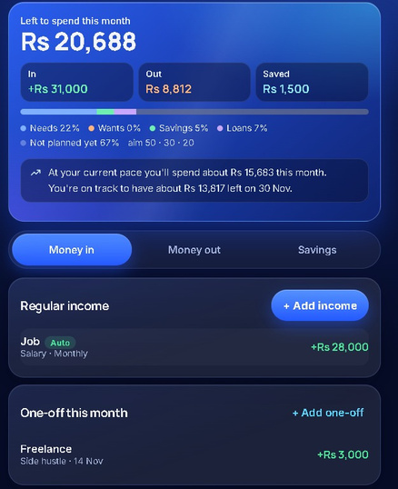
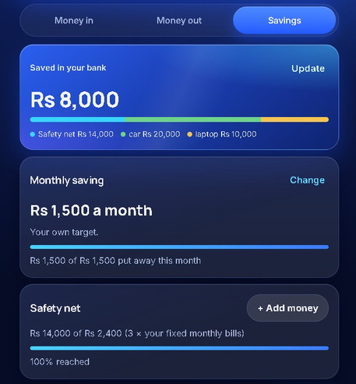
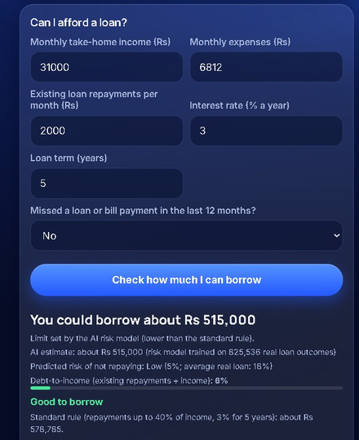
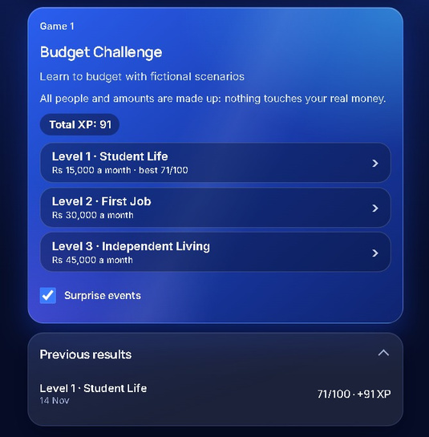




Key Features
Track
income and expenses
Understand
spending habits with simple visuals
Plan
realistic savings goals
Prioritise
needs vs wants
Practise
interactive decision challenges
Income & expenses
Savings goals & safety net
Loan affordability check
Budget challenge
Budget challenge
streaks, badges and levels

Slide 5










PennyWorth
Demo

Slide 6






Conclusion
CURRENT FEATURES
Budgeting, savings goals, safety net and loan affordability check, on secure cloud hosting that scales.
FUTURE IMPROVEMENTS
Spending insights, bill and subscription reminders, joint accounts for common goals and a native mobile app .
Thank you for considering PennyWorth.

